Slide 1

Cost Optimization Strategies in Recruitment and Training
Enhancing Efficiency and Reducing Expenses for Sustainable Business Growth

Slide 2

Why Cost Savings Matter
Impact on Profitability
Balancing Cost and Quality
Cost savings in recruitment and training improve profitability and maintain competitive advantage in the market.
Reducing expenses without compromising quality ensures resources are used efficiently while maintaining high standards.
Investing in the Future
Savings enable companies to invest in innovation and employee development, fostering long-term success and organizational growth.

Slide 3

Current Challenges in Recruitment and Training Costs
1
Lengthy Hiring Processes
1
Inefficient Training Programs
Time-consuming processes delay workforce readiness and strain budgets.
Significant time and material costs hinder employee development and readiness.
2
Costly Recruitment Agencies
2
Scaling Training Challenges
External agencies and job advertising add significant financial burden, especially for specialized roles.
Difficulty in scaling training for diverse needs results in inconsistent skill levels across the workforce.
3
High Turnover Impact
Repeated hiring expenses disrupt organizational stability and productivity.

Slide 4




Streamlining Recruitment Processes
Optimize hiring efficiency through strategic process improvements and technology adoption.
Craft Targeted Job Descriptions
Clear descriptions attract suitable candidates quickly and minimize irrelevant applications.
Automate Candidate Screening
Utilize applicant tracking systems (ATS) to reduce manual effort and improve efficiency.
Implement Structured Interviews
Ensure consistency and fairness in evaluating candidates for improved hiring accuracy.

Slide 5


Digital Outreach and Coordination
Leverage Online Platforms
Social media and online platforms provide cost-effective outreach, expanding reach to a broader pool of potential candidates.
Coordinate Hiring Teams Efficiently
Reduce time-to-hire by coordinating hiring teams and scheduling efficiently, minimizing delays and speeding up the recruitment process.

Slide 6








Leveraging Internal Talent
Cost Efficiency
Boosting Morale
Promoting from within and using employee referrals lower recruitment expenses by reducing external hiring needs.
Internal promotions boost employee morale and retention through career development opportunities.
Engaged Workforce
Company Culture
Leveraging internal talent creates a more engaged and cost-efficient workforce aligned with organizational goals.
Internal hires accelerate onboarding as they are already familiar with company culture, ensuring smoother transitions.

Slide 7

Effective Onboarding to Reduce Training Costs
01
Structured Orientation Programs
Focus on essential skills to accelerate employee readiness and cut training expenses.
02
Clear Role Expectations
Provide resources from day one to minimize downtime and help employees adapt faster.
03
Mentorship and Peer Support
Enhance learning through collaboration and accelerate skill acquisition among new hires.
04
Tracking Progress with Checklists
Use milestones to ensure consistency and monitor employee development effectively.

Slide 8






Using E-Learning and Digital Training Tools
Cost Savings
Flexible Learning
Enhanced Engagement
E-learning platforms reduce travel and venue costs associated with traditional training methods.
On-demand modules allow employees to learn at their own pace, improving retention and adapting to individual needs.
Interactive content and assessments make learning more dynamic and effective for employees.
Efficient Updates
Scalable Training
Easy updates ensure training materials remain current without reprinting costs.
Digital tools enable organizations to train larger groups efficiently and consistently without compromising quality.

Slide 9
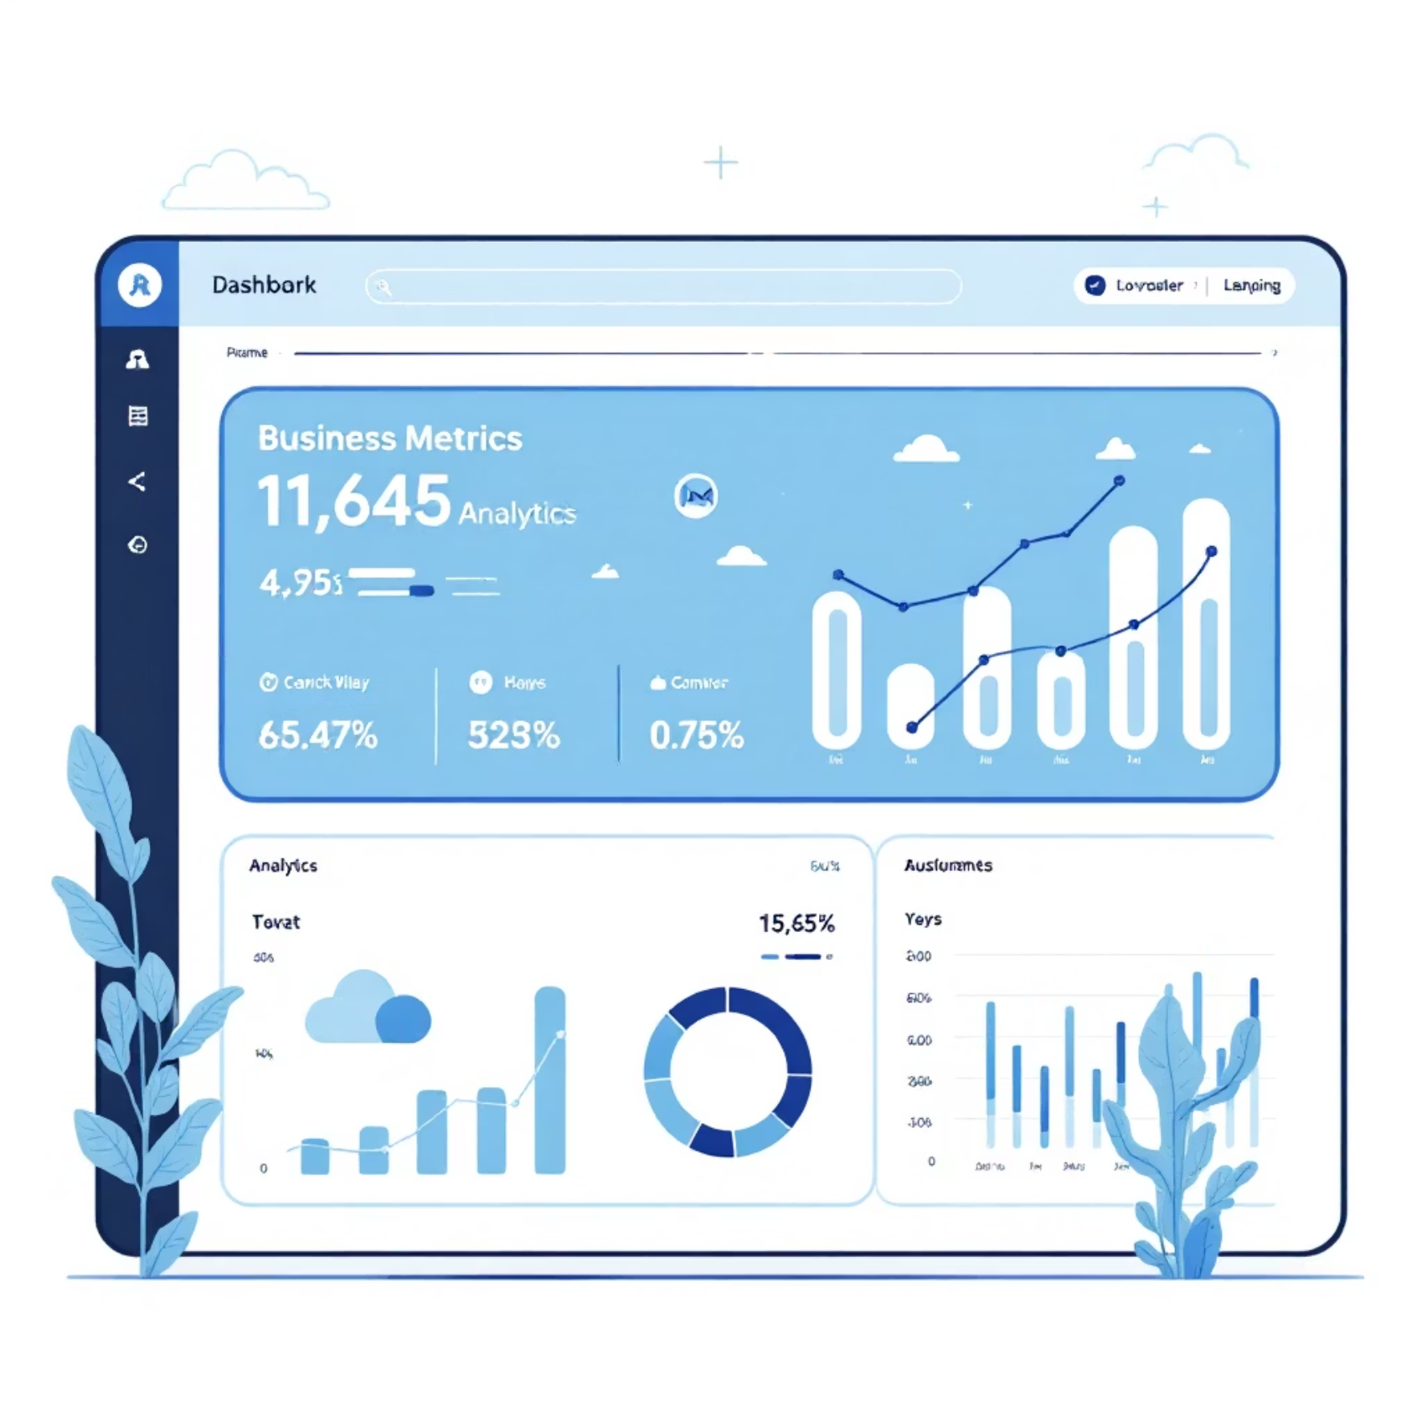
Measuring ROI and Continual Improvement
Monitor Recruitment Metrics
Track cost-per-hire and time-to-productivity metrics regularly to identify areas where savings can be maximized.
Evaluate Training Effectiveness
Assess training outcomes through performance evaluations and feedback to ensure alignment with organizational goals.
Identify Bottlenecks
Pinpoint inefficiencies in recruitment and training processes to optimize resource allocation.
Refine Strategies
Leverage data-driven insights to continuously improve recruitment and training for sustainable cost control.

Slide 10






Action Plan for Cost Optimization
Streamline Recruitment
Utilize technology and establish clear processes to make recruitment more efficient, reducing time and costs.
Leverage Internal Talent
Focus on internal talent to minimize the need for external hiring and significantly cut recruitment expenses.
Optimize Onboarding
Implement efficient onboarding programs to save training time and resources, ensuring quicker employee productivity.
Adopt E-Learning Tools
Use scalable and flexible e-learning tools for cost-effective and accessible training delivery.
Measure and Refine
Establish metrics to track ROI and continuously improve cost-saving strategies for sustained alignment with efficiency goals.

